Slide 1
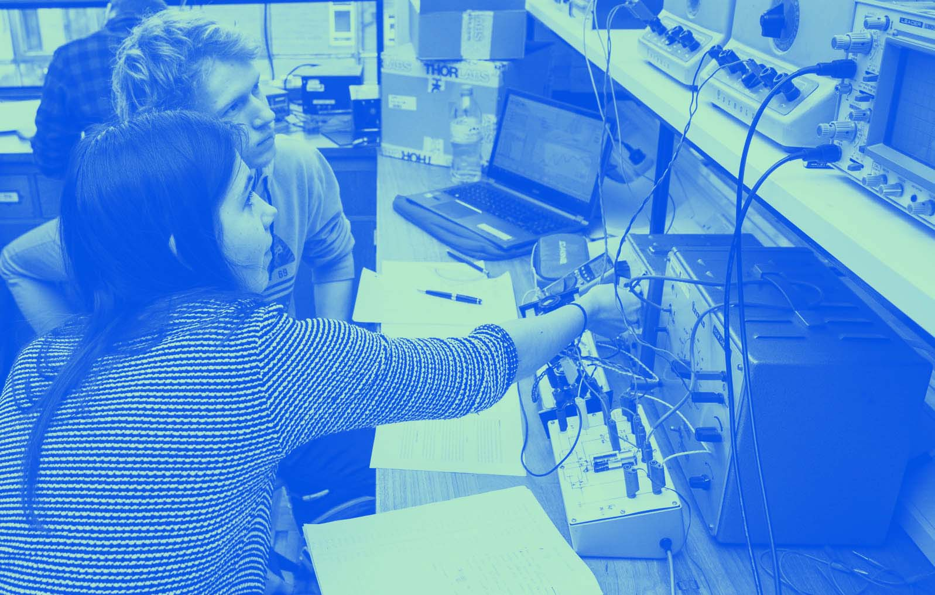
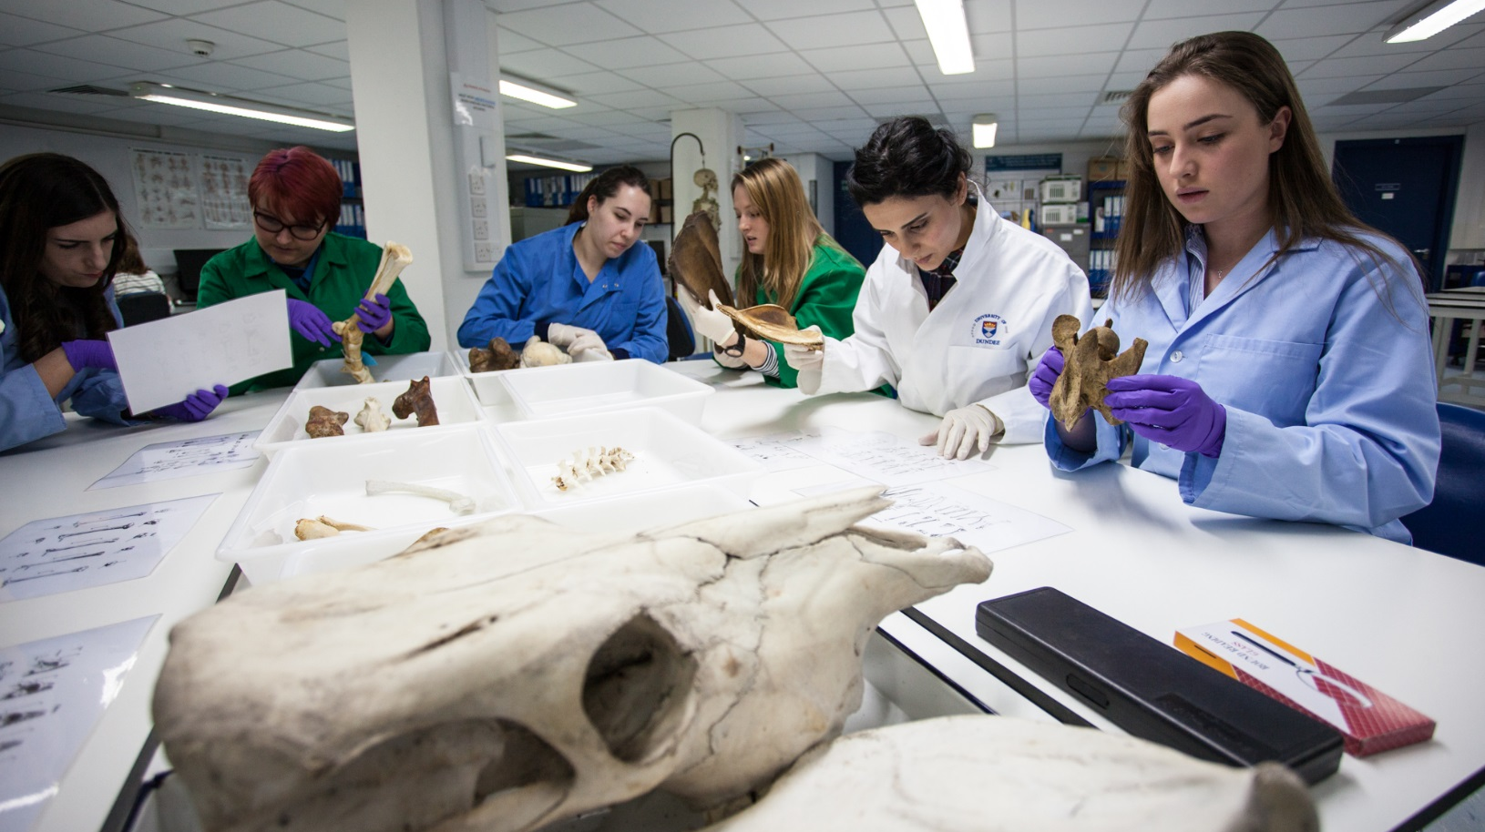
Data Structures and Algorithms
Assignment 3: TEAM PROJECT

Slide 2
Team Project Intro
What is the project?
What are the deliverables?
Marking scheme
Peer Review
AI Declaration
Team working information

Slide 3

What is the project?
To create your own social media application
Could it be the next Snaptok or Tikstagram?

Slide 4
Main requirements
Your program will store a collection of friends – you, and others
Each friend/user has a profile with their name, ID, hometown, and workplace
You will have a list of friends
Your friends will have their own friends in turn, including each other and you
Data for your network will be held in a file (all friends / users and their inter-connections)
You can manually define the data in the file to provide a ready-made network
You may consider the possibility of allowing people to add or remove friends through your program (but this isn’t mandatory, it would be an added extra).
You program should load the ready-made network from the file into an in-memory representation, ensuring all links and connections are correct.
When loaded, the program can present you with your profile along with options about what to do, e.g., edit profile, view friends

Slide 5
Main requirements (2)
You can display a list of all your friends
You can filter your friends, e.g., show those with the same workplace or hometown as you
Extra: search for all friends with certain letters in their name, e.g., all friends with ‘smi’
You should be able to select one of the friends in your list to view their profile and view their list of friends too
When viewing a list of your friend’s friends, you can choose to add one to your own friend list
When viewing a list of your friend’s friends, you can filter the display to show any friends that you (already) have in common
Look for friend recommendations: the ability to search through one (or all) of your friend’s friends to determine any that have the same hometown or workplace as you that aren’t already your friend but could be
The ability to save your social network to a file on disk and have it reinstated successfully.
A (text-based) menu OR GUI system to facilitate the above

Slide 6
Added extras
You will be given additional credit for any other reasonable extensions to your completion, for example
Allowing you or friends to make ‘posts’ and have ‘likes’
Being able to add or remove users from the network
Considering the efficiency of certain queries in your choice of data structures and algorithms
Any other sensible addition. Please ask if you are unsure.

Slide 7
Deliverables
Report:
Due Friday 19th of June @ 23.59
Introduction, outline of requirements
Initial designs (classes, user interface)
Discussion and selection of data structures being used
Member contributions
Your program
Source code, JAR file
Presentations
Will take place on Monday, Tuesday, and Wednesday, 12th to 14th of June

Slide 8
Marking scheme
Core Requirements Implementation of core data structures and queries with text-based menu system. | out of 30 marks
Extra features E.g., GUI, other features. | Up to 5 marks
Report(s) Final Report (10%) | out of 30 marks
Presentation | out of 15 marks

Slide 9
Peer Review
All team members are expected to contribute to the task
All team members need to be allocated significant programming tasks
At the end of the project each team member should submit a peer review
describes the contributions made by themselves and others to the team work and a rating for that contribution
Marks *may* be deducted for poor teamwork.
E.g. not working together as a team
Not allocating appropriate tasks to all team members
Not supporting each other
Will use the online Peer Review system

Slide 10
Team Allocations
Teams have been allocated to all students
Group Assigned document upload on MyDundee
Students will work in a group of 3

Slide 11
Team working
What is a team?
Team roles, responsibilities
Pro-group behaviours
Anti-group behaviours
Some golden rules

Slide 12
What is a team?
A team is a collection of individuals who work together towards a common, shared objective
Individuals
Have different skills, strengths and weaknesses
Assume different roles in a team
Leader, worker, finisher, motivator,
Communicate in different ways
Reflecting versus spontaneous contribution
Have different demands on their time
Other courses, extra curricular activities and responsibilities

Slide 13
Team planning
Ensure everyone understands (and agrees upon) what the objective is
Ensure that everyone is clear about what they are supposed to be doing and have the same expectations – don’t make assumptions
Make sure deadlines are clear and achievable
Everyone should be involved in coding
Everyone must be allocated coding tasks

Slide 14
Planning your work
Meet, communicate, plan, complete, review and deliver
Initial meeting (and then regular meetings thereafter)
Decide how to share information (shared docs, GitHub etc.)
Think about tasks that need to be performed (and deadlines)
Writing the requirements
User interface designs (text-based or GUI)
What data structures to use? What classes? Produce a system design
Define the classes, and the most important fields and methods
Writing the code
Data structures, menu system, file writing logic, etc.
Documentation including commenting of code
Reviewing
Testing (test plan defined early in project and then completed test sheets)

Slide 15
Planning your work (2)
Define roles / tasks for each other
Do you want a team leader?
Delegate work to each other (assign tasks)
Write a class that does …
Add method(s) to class ‘Y’ for …
Add test methods to class ‘z’…
Add a ‘requirements’ section to the team report
Etc.
NOTE: EVERYONE MUST CONTRIBUTE TO THE PROGRAMMING
Set deadlines for tasks
Realistic estimates of time to complete a task
Measure progress
Don’t leave it all until the day before a deadline

Slide 16
Pro-team behaviours
Attending class sessions and meetings
Contributing to work and discussions
Constructive inputs and criticisms
It’s ok to question but look for the way forward.
Working within agreed timescales
Completing work which is assigned to you
Having a can-do attitude
Communicating, keeping people aware of progress
Supporting each other
Clarifying. Pair programming?
Including each other in discussions
Asking for help!

Slide 17
Anti-team behaviours
Lack of attendance
Not responding, communicating
Not contributing to work
Delivering work late or on the day of the final deadline
Not allowing others to contribute (seeking to do all of the work yourself)
Negative criticisms
Undermining others
Not making clear what the expectations are
Others can’t be mind readers

Slide 18
Some golden rules
Clear roles, expectations and timescales
Everyone knows who is doing what and when
Progress can be gauged
Communicate
Keep others aware of progress and status
Raise issues in case workarounds are required
Don’t get stuck
Do the work!
Ask for help if you need it

Slide 19
Why teams?
An essential skill for any workplace
Industry, academia, part-time work
It is rewarding to share a problem with others and complete it with others
Enhancing employability
being able to work effectively alongside others is a skill that you really should be practising from early on and throughout your time at University.

Slide 20
Managing information
Use shared documents to work on?
Use source control to manage source code?
E.g., GitHub etc.
Make sure everyone knows how to use it properly!
It is up to each team to decide how best to manage communication, and to document and implement the system
I can set up channels for teams if required

